Slide 1


Ensemble Learning
陆鑫益

Slide 2
Contents
1
2
3
4
Decision Tree
Bagging
Boosting
Stacking

Slide 3
1 Decision Tree
ID3：information gain
C4.5：information gain ratio
CART
classification：Gini index
regression：Least square

Slide 4
1 Decision Tree
ID3：information gain
C4.5：information gain ratio
label
Data size

Slide 5
1 Decision Tree
CART——Binary tree
Least squares regression tree
Classification tree
Pruning
Use validation set

Slide 6
Why ensemble？
Assume：
In a binary classification task
We have T weak base classifiers h (accuracy and diversity)
By voting
Hoeffding inequality:

Slide 7
Why ensemble？
In reality, base models are correlated.
Diversity
Assume:
for regression task, we have T base models, h₁ to h_{T}
We can define the ambiguity:
And the error:

Slide 8
Why ensemble？
Yes
bagging
Random forest
Are base models
highly correlated？
Adaboost
GBDT
Xgboost
No
boosting
Model generalization：
Bias: fitting ability
Variance: adaption of different dataset
Noise: the lower boundary of the error

Slide 9
2. bagging
Bootstrap Sampling
Diversity
Sample and put back

Slide 10
2. Bagging
Random Forest
Diversity
Decision Tree
Consider random feature group when splitting
Bootstrap sampling

Slide 11
3. Boosting
Adaboost
Algorithm:
Additive model

Slide 12
3. Boosting
Boosting Decision Tree
Algorithm:
For binary classification task
BDT is similar as Adaboost.
For regression task
Why residual error？

Slide 13
3. Boosting
GBDT (gradient boosting decision tree)
Regulation：
1. Tree Constraints
2. Shrinkage
3. Random sampling

Slide 14
3. Boosting
Xgboost (Chen T, Guestrin C. Xgboost: A scalable tree boosting system）
Add regulation term in objective function
Use second-order taylor expansion

Slide 15
3. Boosting
Xgboost (Chen T, Guestrin C. Xgboost: A scalable tree boosting system）
Approximate algorithm
Shrinkage
Column sampling
Missing value
Parallel

Slide 16
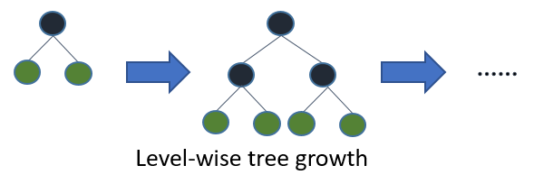
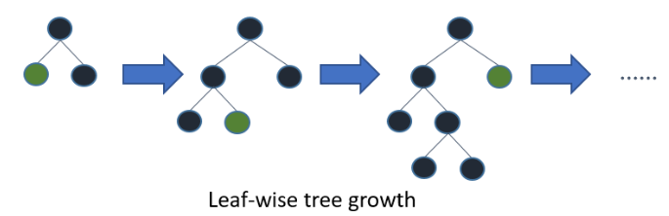
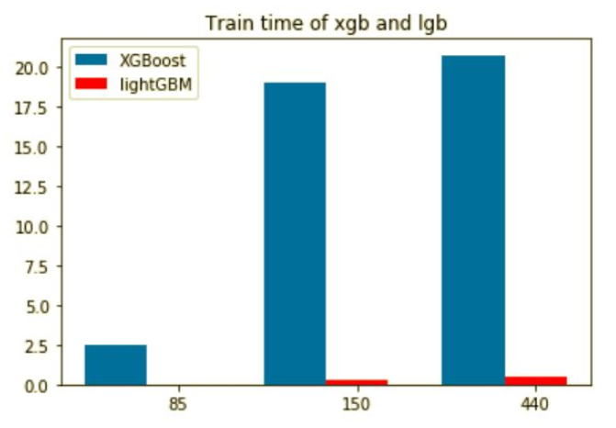
3. Boosting
LightGBM (LightGBM: A highly efficient gradient boosting decision tree）
Histogram-based Algorithm
Leaf-wise not level-wise
Gradient-based One-Side Sampling
Exclusive Feature Bundling

Slide 17
4. Stacking

Slide 18
5. Tips
Feature engineering is important.
Independent features are preferable
Xgboost VS NN

